Slide 1
Paper Reading
金旭
2018-3-30

Slide 2
AMRMF
Adapative Manifold Regularized Matrix Factorization for Data Clustering
Author : Lefei Zhang, Qian Zhang, Bo Du, Jane You, Dacheng Tao

Slide 3




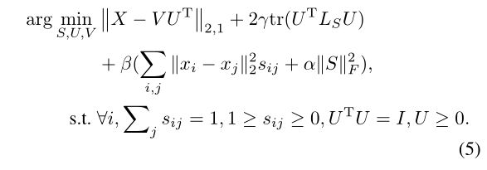
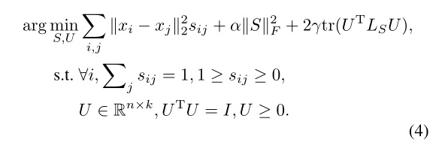
AMRMF
Method
Original NMF：
Use L2,1 norm：
Add similarity constraint:
V
Combine (2) and (4) together：

Slide 4
AMRMF
Others
Most of exist methods directly introduce the Gaussian kernel derived Laplacian matrix for manifold regularization, while ignore to explore a more meaningful affinity matrix to better regularize the model.
The standard NMF uses the L2-norm based squared residue minimization to measure the loss, which would be easily effected by the noises and outlines.
Advantages
scalable
Jointly learns an affinity matrix with the matrix factorization
Employs the L2,1-norm

Slide 5
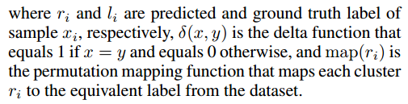



AMRMF
Experiment
Measurements :
Clustering accuracy (ACC)
Normalized mutual information(NMI)

Slide 6
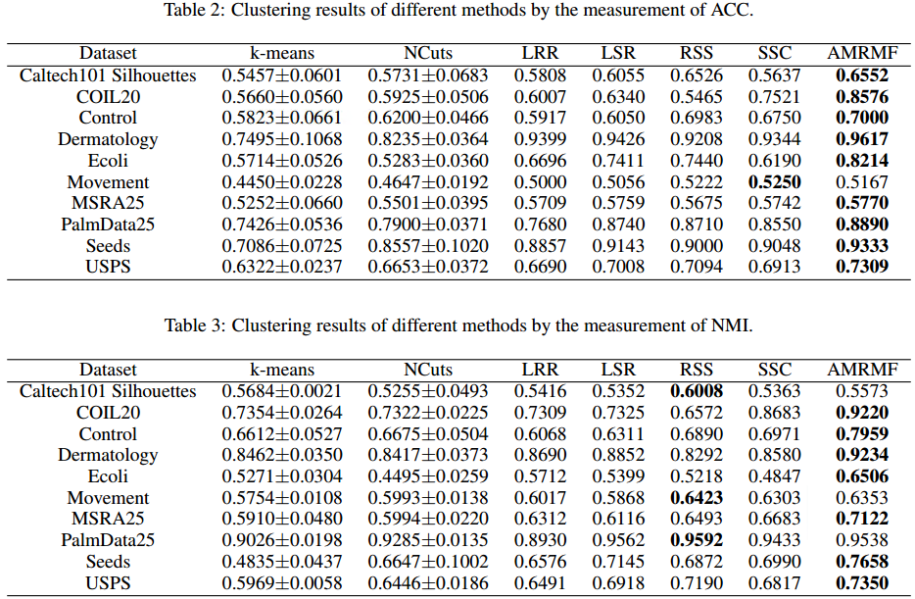
AMRMF

Slide 7
AMRMF
What we can learn : Use L2,1 norm instead of L2 norm ,which is more unsensitive to noise

Slide 8
MCNMF
Multi-Component Nonnegative Matrix Factorization
Author : Jing Wang, Feng Tian, Xiao Wang, Hongchuan Yu, Chang Hong Liu, Liang Yang

Slide 9













MCNMF
Method
Original NMF：
Represent X by V component simultaneously：
Enforce different component independent from each other by HSIC:
Use inner product kernel for HSIC and ignore the coefficient:
Final iteration function:

Slide 10
MCNMF
Advantages
It captures more comprehensive information and interprets data from different perspectives, by leveraging the multiple components. Instead of factorizing the data matrix into a single basis and representation matrix, MCNMF learns multiple representations based on different basis matrices.
HSIC explores the diverse information among the representations, where each representation corresponds to a component.

Slide 11
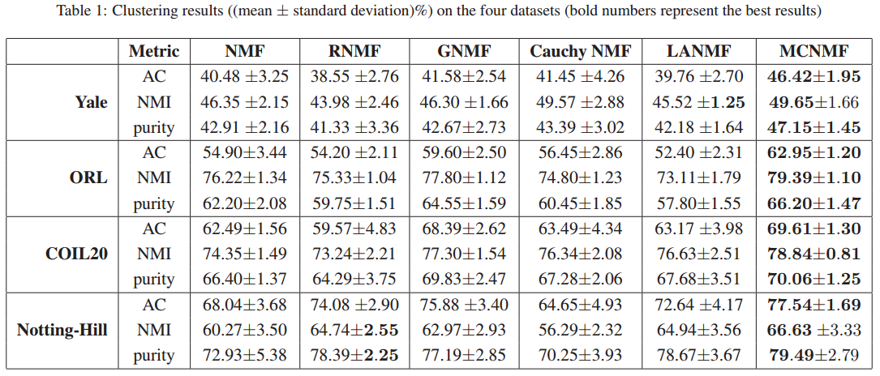
MCNMF
Experiment
Measurements : Accuracy (AC), Normalized mutual information(NMI), Purity

